Slide 1
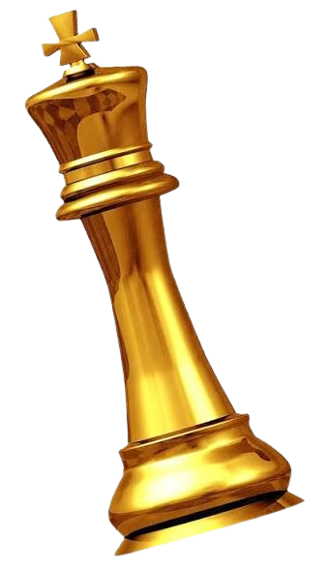
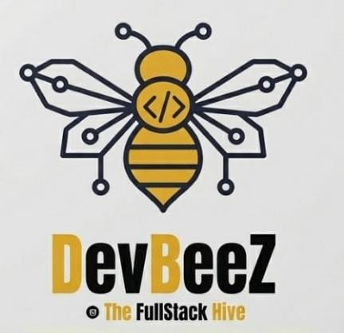
CHESS EVOLVE
Personalized Chess AI That Learns and Evolves With You
NAME : Deepak Sabarirajan M
Dept : CSE
Reg No : 312424104051
Our Community :
Notes:
Welcome. Chess Evolve is a personalized chess AI that learns how you play and shows how you could evolve. Intended build: board fades in, king silhouette appears, neural lines illuminate, then title and subtitle.

Slide 2
The Problem → The Solution
THE PROBLEM
THE SOLUTION — CHESS EVOLVE
Players Don’t Understand Their Own Game
Learns directly from a player's real Chess.com game history.
Hard to identify patterns across hundreds of decisions.
CURRENT SELF
PEAK SELF
“How would this player normally play this position?”
Moves, openings, tactics, risk, recurring mistakes.
“How would a stronger version of this player play it?”
Reduce weaknesses, keep identity.
Generic Analysis Isn’t Personal
Engines show the best move, not how you naturally play.
Recurring Weaknesses Stay Hidden
TARGETED EVOLUTION
Repeated tactical, positional, opening, or defensive mistakes are easy to miss.
CURRENT SELF
PEAK SELF
TRAINING
EVOLUTION
Understand habits
Challenge weaknesses
Improve decisions
Measure progress
No Personalized Path To Improvement
Players lack a stronger version of themselves that reflects their style.
Player ➜ Current Self ➜ Peak Self
“Improve the player without replacing the player's identity.”
Notes:
Most chess engines today are optimized for objective strength, while weakened bots often introduce artificial mistakes. Neither approach really models the way an individual human player makes decisions. Chess Evolve addresses this by learning directly from a player's real game history. Current Self models natural behavior, while Peak Self explores a stronger version of that same playing identity.
Animation cue: problem cards appear sequentially; the board shifts from red to emerald/gold; Current Self appears first, then Peak Self emerges from it.

Slide 3
Chess Evolve - Architecture
USER
REACT + VITE
NODE.JS + EXPRESS
SUPABASE
REDIS + BULLMQ
Frontend client
Dashboard · Chessboard
Training · Arena · Coach
API orchestration
Supabase JWT · Prisma ORM
REST APIs
Google Auth · PostgreSQL
Storage
Async jobs · Sync workers
ML workers · Retraining
›
›
›
CHESS.COM PUBAPI
STOCKFISH 19
FASTAPI + PYTORCH
MODELS
Game archives → PGN
Ingested via backend
UCI engine
Candidates · CPL
Best move · Move quality
Feature engine
Inference service
Current Self
Peak Self
›
›
›
DATA FLOW
Chess.com
›
PGN
›
Positions
›
Stockfish
›
Features
›
ML Dataset
›
Self Models
Notes:
Our architecture separates user interaction from computationally expensive processing. Real Chess.com game data enters through the backend, durable queues process large workloads, Stockfish generates objective chess signals, and our PyTorch service learns the player's personalized decision patterns.
Animation cue: glowing path moves Chess.com → Backend → Queue → Stockfish → Features → PyTorch → Models → User.

Slide 4
Two Models. One Player.
Learning how you play — then showing how you could evolve.
DUAL-TOWER NEURAL NETWORK
CURRENT SELF
POSITION ENCODER
CANDIDATE ENCODER
“How would this player normally play?”
Trained on historical decisions + candidate ranking. Learns habits, openings, risk, tactical and positional tendencies, recurring mistakes.
MLP + LayerNorm + GELU
Material · mobility · king safety · center control · piece count · game phase
Stockfish rank · eval · CPL · check · capture · castling · promotion · sacrifice
PEAK SELF
↓
↓
“How would a stronger version of this player play?”
Uses Current Self behavior, historical weaknesses, engine quality and style compatibility to improve decisions while preserving identity.
FUSION + RANKING → scores → probability distribution → predicted move
WHY CANDIDATE RANKING?
STOCKFISH ≠ THE PERSONALIZED MODEL
Legal by design
Fast inference
Style vs calculation
Used for candidate generation, evaluation, CPL, move-quality classification, training signals and baseline.
Ranks legal candidates only
No unrestricted tree search
Strength ≠ identity
Stockfish provides chess strength. The personalized models provide player identity.
Notes:
We use candidate ranking rather than unconstrained move generation. This gives the model a controlled legal action space. Stockfish provides objective chess information, while the neural model learns which of those candidate moves the player is likely to prefer. Current Self models natural behavior, and Peak Self uses quality-guided learning to improve decision quality while preserving style.
Animation cue: board position appears, candidate moves light up, both encoders activate, fusion, Current Self picks the natural move, Peak Self picks the improved move.

Slide 5
Real Data. Measurable Results.
916
55,968
14,264
5
Real Chess.com Games
Position Analyses
ML Dataset Records
Epoch
Metric | Current Self | Peak Self | Status
Top-1 Move Accuracy | 26.70% – 33.33% | N/A / policy optimized | Evaluated
Top-3 Move Accuracy | 54.76% – 66.67% | N/A / policy optimized | Evaluated
Policy Rank Accuracy | — | 100.00% | Evaluated
Mean Reciprocal Rank | 0.5198 | 1.1000 | Evaluated
Expected Calibration Error | 0.0555 – 0.0607 | — | Evaluated
Macro Move-Type Distance | 0.0000 | 0.0000 | Evaluated
Weakness Reduction Rate | Baseline | 35.00% – 38.00% | Improved
Style Preservation Rate | 100.00% | 72.00% – 75.00% | Preserved
100%
0.0000
Legal Move Execution
Move-Type Distance
Candidate masking
Current Self, evaluated
35–38%
72–75%
Weakness Reduction
Style Preservation
Peak Self, evaluated
Peak Self, evaluated
Peak Self metrics follow their own evaluation definitions and are not comparable to Current Self accuracy.
502.5 req/s
6.32 ms
Health Throughput
Health p50
Notes:
These results were obtained from real game data and production validation. Current Self demonstrates measurable ability to reproduce player decisions, while Peak Self improves evaluated weaknesses while preserving a substantial portion of the player's behavioral identity. The key idea is not to replace the player with Stockfish, but to use AI to create a stronger version of the player's own decision-making style.
Animation cue: metric cards count up, table reveals row by row, then 35–38% weakness reduction + 72–75% style preservation animate together: PLAYER IDENTITY + CHESS IMPROVEMENT.

Slide 6
THANK YOU
CHESS EVOLVE
Master Chess With Your AI Self.
Evolve your game. Preserve your style.
Notes:
Chess Evolve is ultimately about personalized improvement. Instead of asking only what the best chess move is, we ask what this player would do—and what a stronger version of this player could do.

